Slide 1


Slide 2
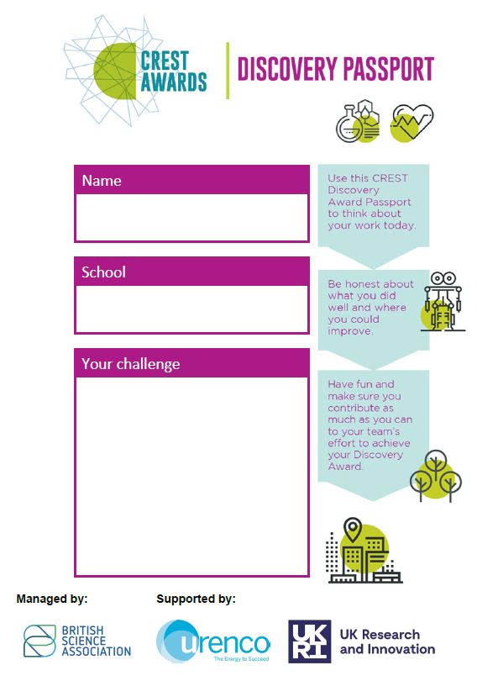
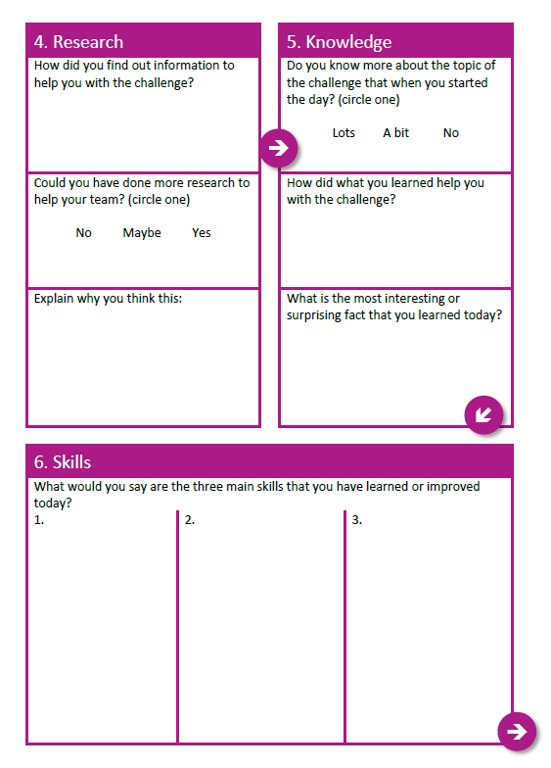
Discovery Award: Passport
Fill out your CREST Discovery Passport throughout the day to document your learning and earn your CREST Award.
RECORDING YOUR EVIDENCE:
What’s your role?
Team working
Problem solving
Research
Knowledge
Skills

Slide 3
Team Roles
Project Manager:
Helps other members of the team to gather examples and evidence using various resources, including the workshops, and reports back on this as part of the presentation.
Research Manager:
Ensures that the implications of the design ideas are thought through. Responsible for researching the materials and technology required to make the design ideas work.
Engineer:
Responsible for ensuring that the team communicates its ideas effectively when presenting to the other teams, and responsible for coordinating the presentation.
Communications Manager:
Responsible for the physical design of the product.
Design Lead:
Responsible for developing a marketing plan and thinking about who this tool would be useful for, how and why.
Marketing Lead:
Responsible for developing a marketing plan and thinking about who this tool would

Slide 4
John Smeaton Discovery project.
ACTIVITY | DESCRIPTION | TIMING
1. Introduction | Using the presentation, students explore the context. The session leader introduces the day and divides students into teams. | 20 mins
2. Context | Public spaces, accessibility and inclusive design. | 30 mins
3. Energy | Teams study generating electricity and renewable energy – practical. | 20 mins
4. Research and design | The teams work together to research and develop their chosen idea in response to the challenge. | 30 mins
BREAK
5. Prototype, test, improve | Teams test out their idea by creating a prototype. Teams prepare their presentations. | 2 hours
LUNCH
6. Presentations | Teams finalise and deliver their five-minute presentations. Teachers and students provide constructive feedback and have a chance to ask questions. | 1 hour
Reflections | Students reflect on their learning and complete their CREST Discovery passport. | 10 mins

Slide 5
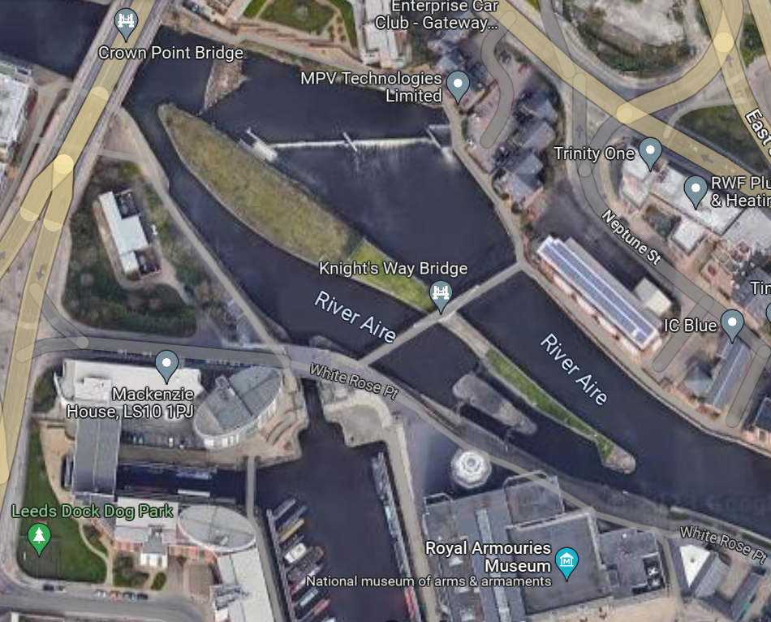
The Brief
You are developers working on Smeaton Park – a brand new public space celebrating the life and work of John Smeaton in your town.
Smeaton Park will be developed on a currently disused strip of land on an island in the middle of a river in the city centre.
As a team of developers, you are interested in how you can use the water around the island to harness renewable energy and make the new park sustainable.
You want the new park to serve the local community:
57% of the local community don't own a car
40% of the local community are between 20-34 years old
46% of households are 1 resident households and are predominantly renters
In the local area, 83% of people have no access to a garden at home

Slide 6
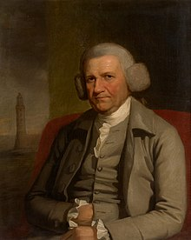
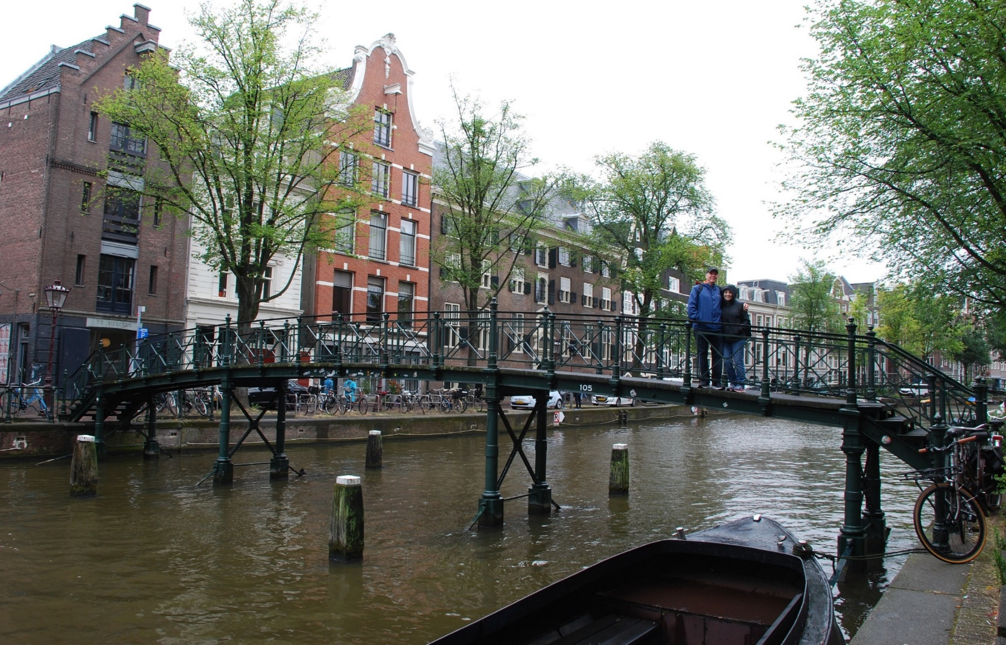
John Smeaton - “The Father of Civil Engineering”
Smeaton 300 celebrates the Leeds-born civil engineer in a series of events and activities across the city.
Born in Leeds, his trailblazing civil engineering projects continue to shape the world around us today.
Smeaton 300 celebrates his life, legacy and influences all the way up to his 300th birthday on 8th June 2024.
Notes:
John Smeaton was involved in hundreds of projects during his lifetime either with sole responsibility or working with other engineers. He is most famous for designing the Eddystone Lighthouse and pioneering the use of concrete and stone. From bridges to railways the impact of Smeaton is still present today in all parts of the UK and abroad. Smeaton is known as the Father of Engineering for all of the developments and improvements he made to the approach and study of engineering which was formerly a military led field.
John Smeaton is known as the Father of Civil Engineering. He came up with the term “Civil Engineering” to describe engineering works that were for the public good rather than for military purposes.
Civil engineering is everywhere. It builds the roads, railways and bridges we use to travel to work, it keeps our buildings standing up, transports goods along canals and protects our coastal towns from flooding.

Slide 7
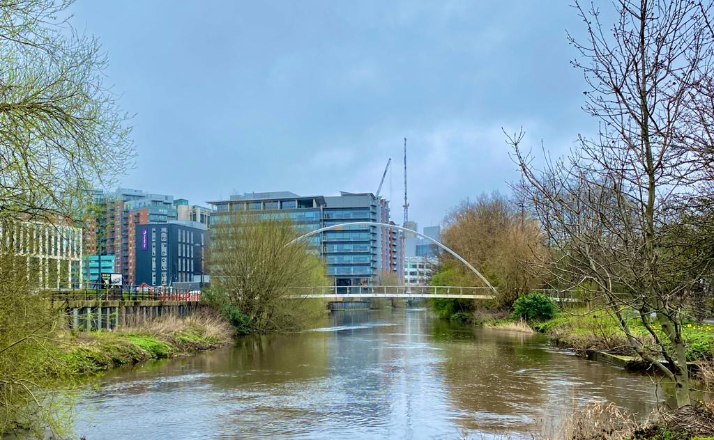
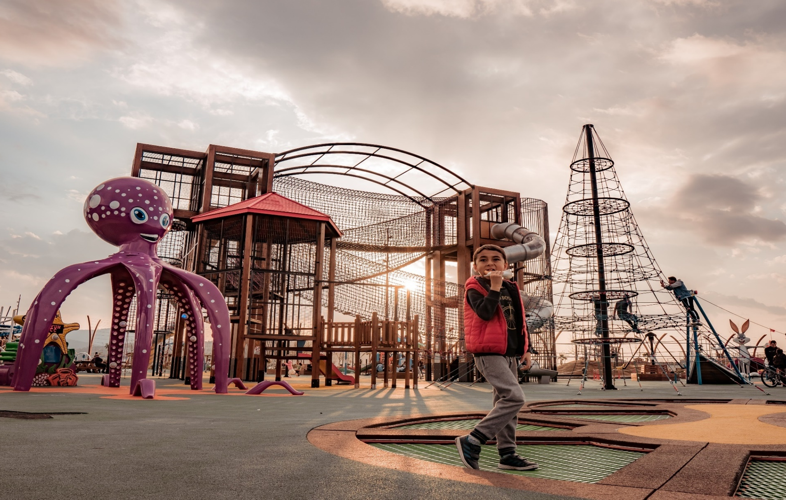
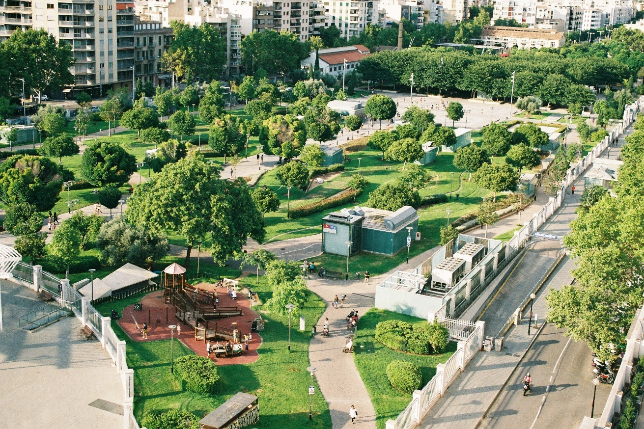
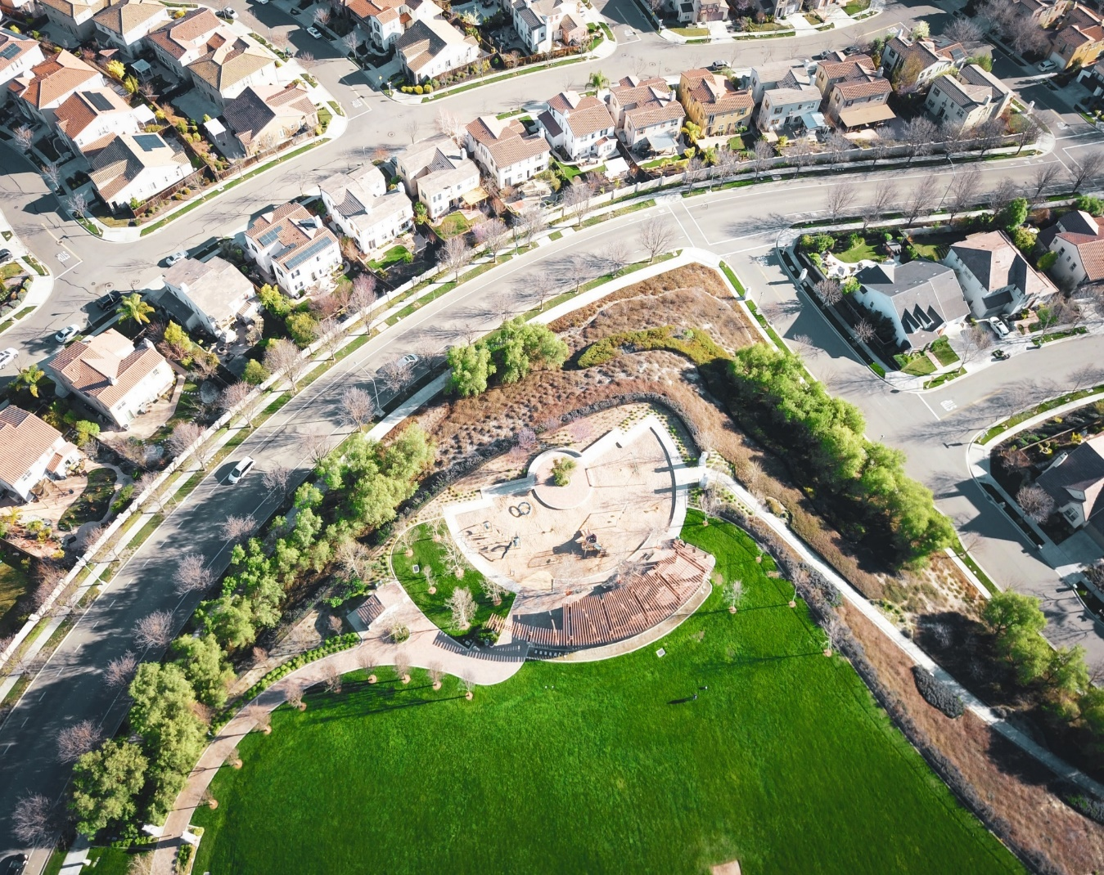
Public Spaces
DISCUSSION:
Who are they for?
What are they for?
Complete Worksheet 1, Task A.
Notes:
Objective: To introduce the question of why public spaces are important in cities, towns and communities to frame the context of this project.
Discuss with students why public spaces are important and give them some time to debate this question in small groups
List all the different types of public spaces either and the role that a public space serves.
Before the 1840s there were no public parks in Britain! As towns spread onto on surrounding fields, people living in cities become more separated from the countryside and its benefits. Campaigners and politicians such as Edwin Chadwick and Robert Peel campaigned for the creation of green spaces for the good of the people.

Slide 8
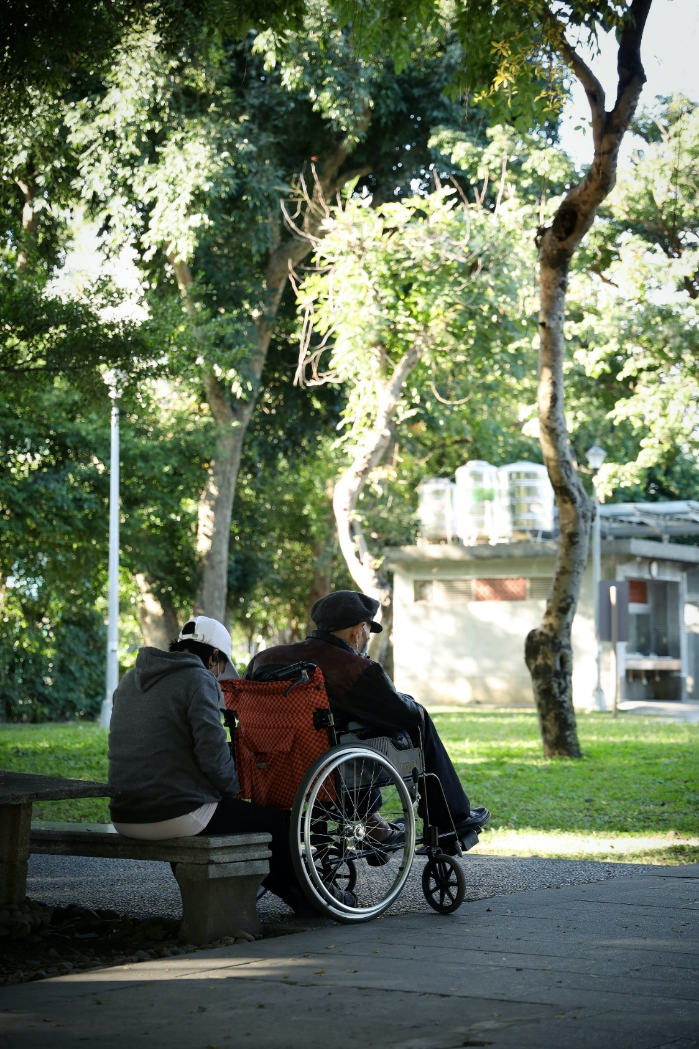

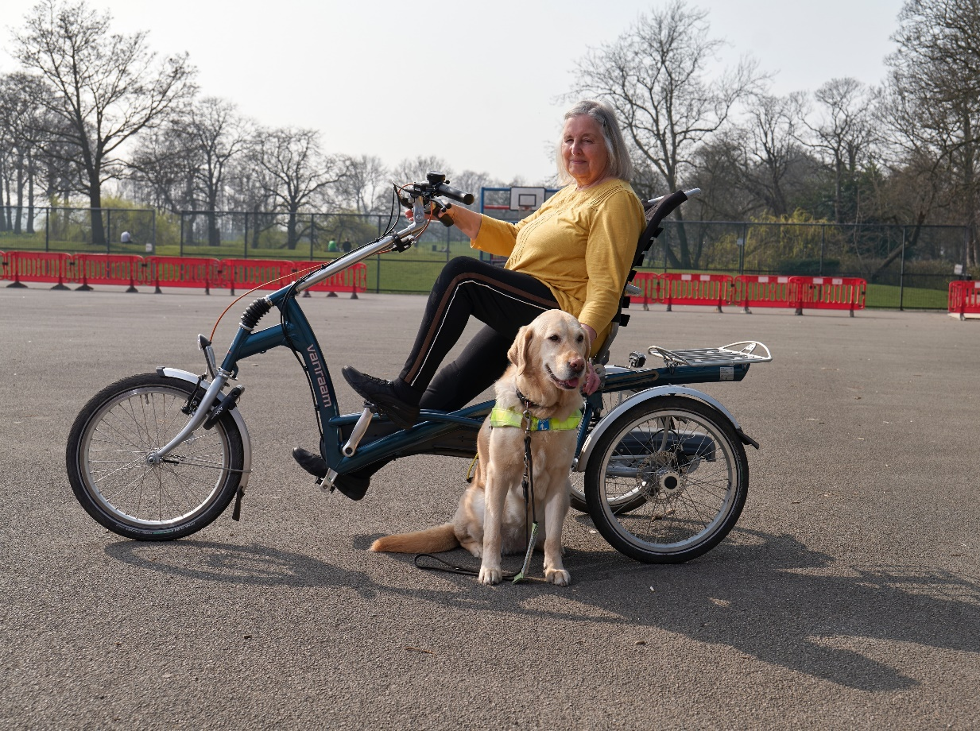
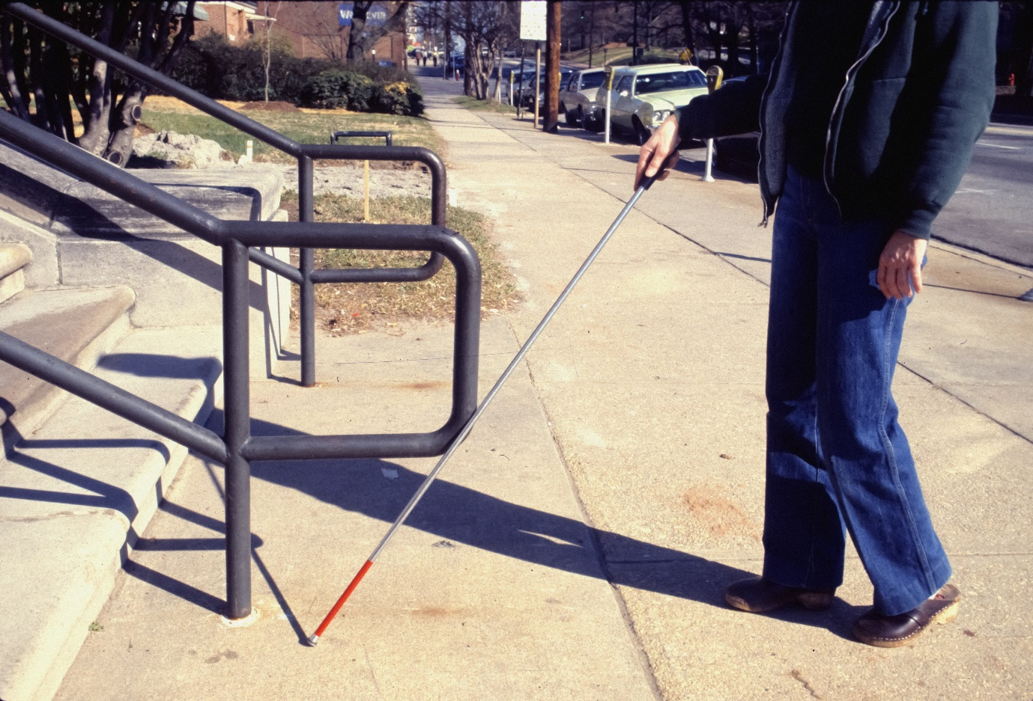
Accessibility
The guiding principle of Inclusive Design is that all design:
landscape, engineering, architectural, product or process,
should respond to the greatest diversity of human needs possible.
Notes:
Ask students to think of a public space they know – eg a park near home or near school. Ask students to either list what is in this space or draw it visually if this helps. Discuss the facilities and services this space offers and ask students how this public space could be improved.
Accessible design. Explain to students that there are a number of considerations when designing for accessibility that involved age and height as well as physical disabilities. Civil engineers and designs are already addressing these in ways they may not have realised in towns and cities all over the world.
It is difficult to design any environment to the exact specifications of every group, much less every individual, it is perfectly possible to design-out known barriers and design-in a high degree of flexibility.

Slide 9
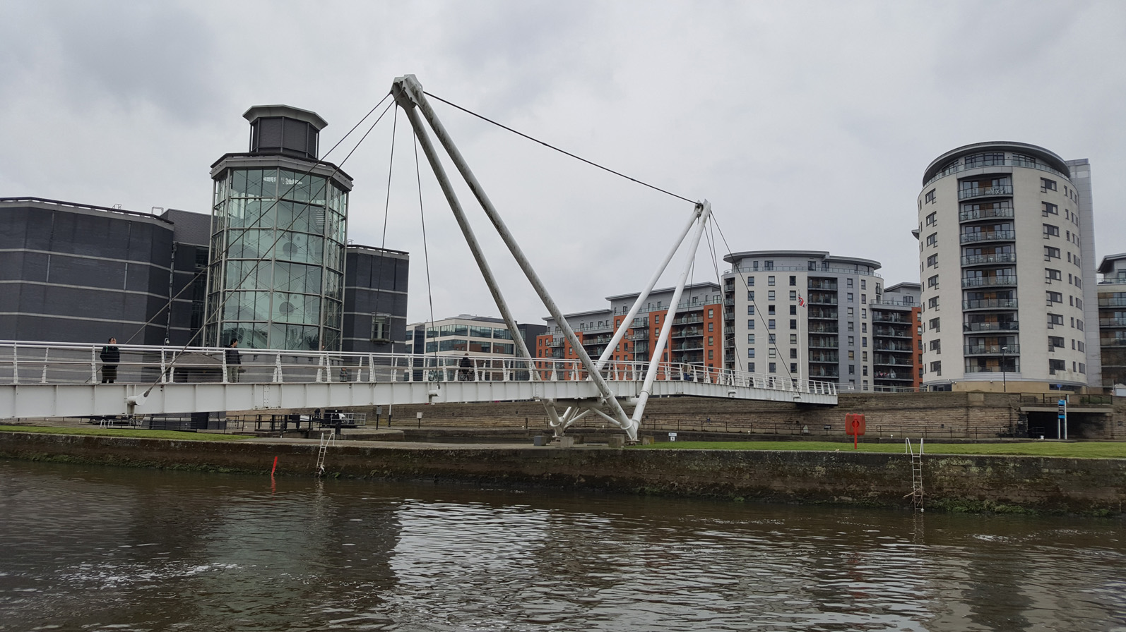
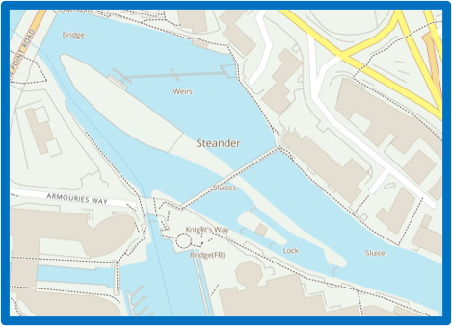
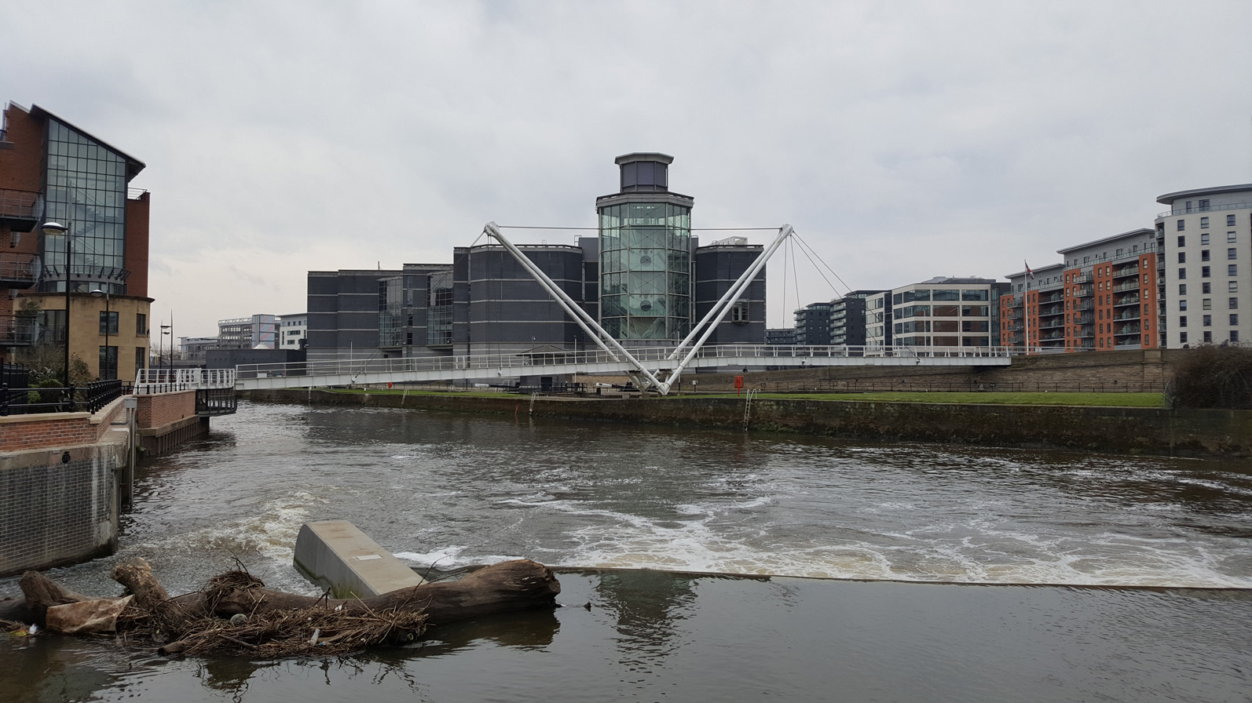
Location and Access
Location map for Smeaton Park (Fearn’s Island) Leeds Dock.
Where and how could you access the island?
Link to Google Maps location

Slide 10
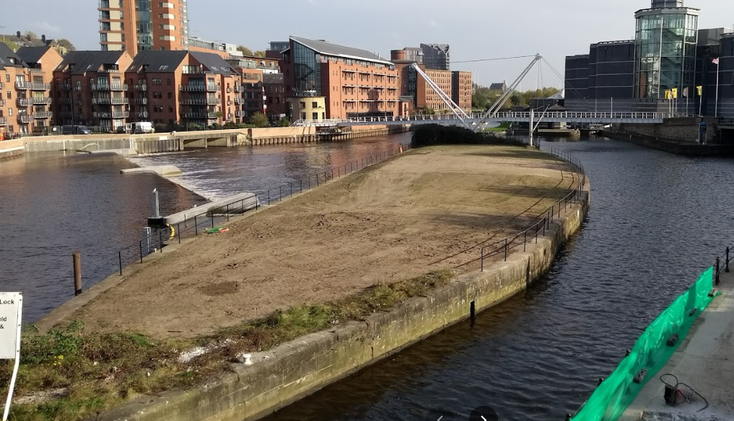
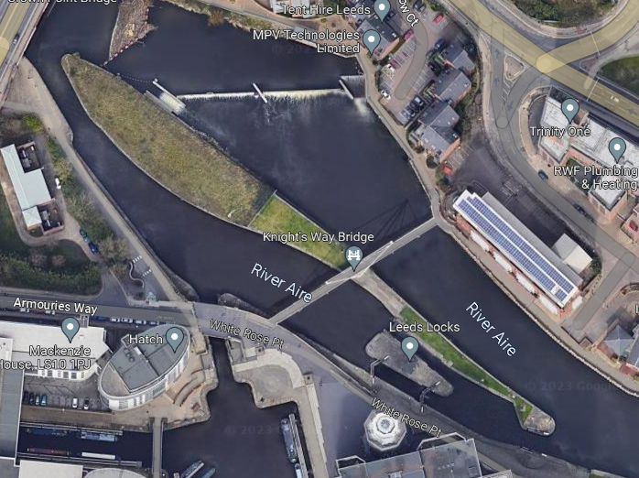
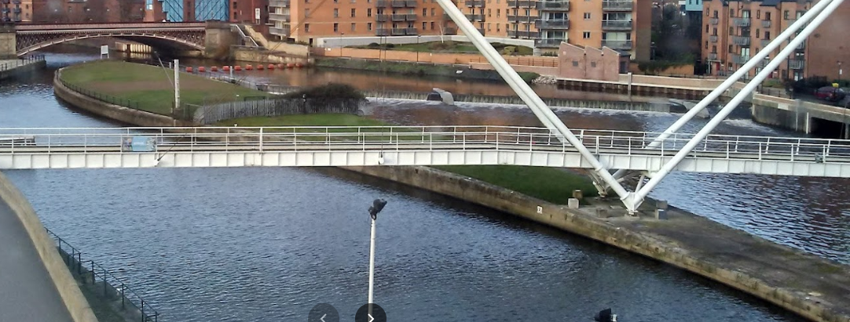
Images from Google Maps
Subject to permission.
Link to Google Maps location

Slide 11
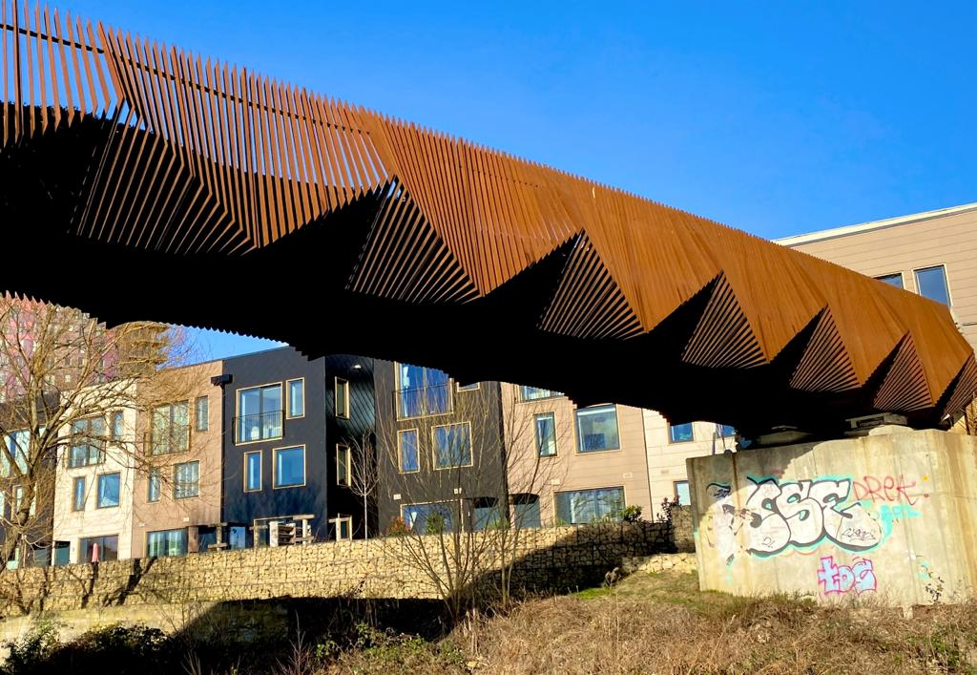
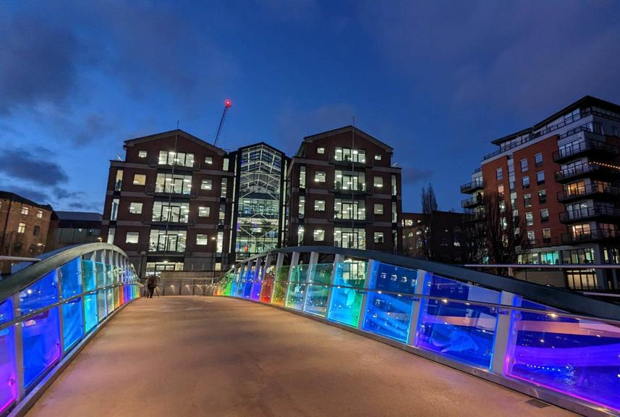
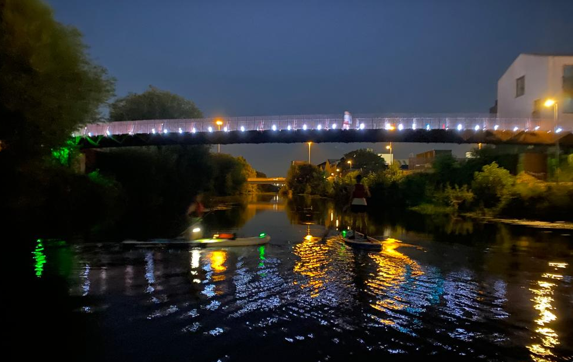
Bridge Examples
Did you know Smeaton saved London Bridge from falling down?
Here are some of the existing bridges around Leeds.
These bridges are not intended for vehicles.
You need to design a bridge to access the island that is at least 5 metres long and a maximum of 20 metres (see map).
Consider who will need to use the bridge(s) and where it/they will be best located.
Notes:
The students will need to design a bridge to the island, they can choose the style, number and location of the bridge.
Talk to the students about who needs to use it, consider visitors as well as services such as maintenance and obviously contractors that will be working on the park. There are no restrictions on the bridge in this project - consider budget and materials but students may want to utilise technology such as moving pavements, energy recovery etc. Bridge design could be allocated to 1 or 2 students in the group as part of the division of tasks.

Slide 12
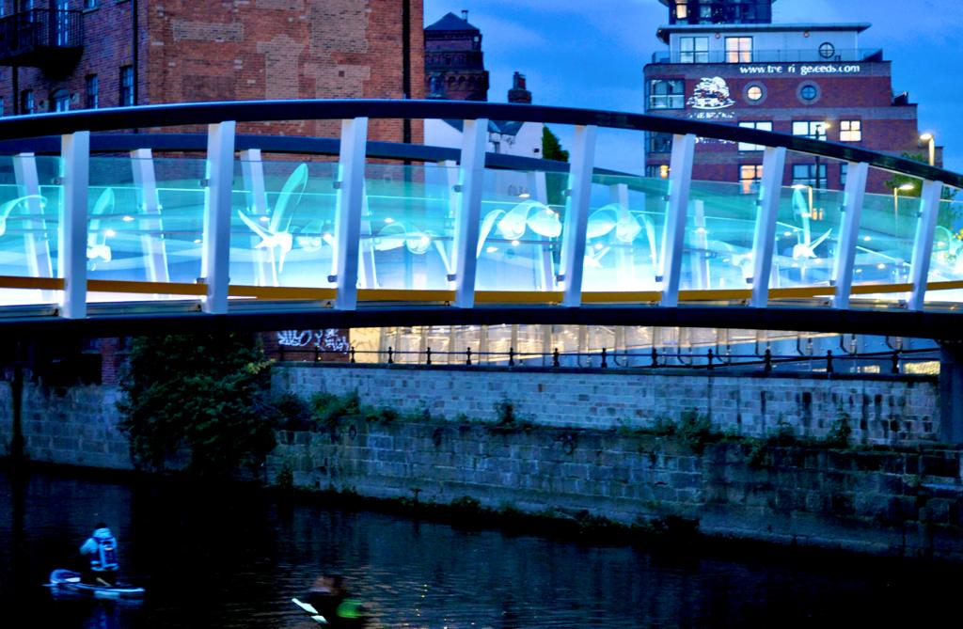
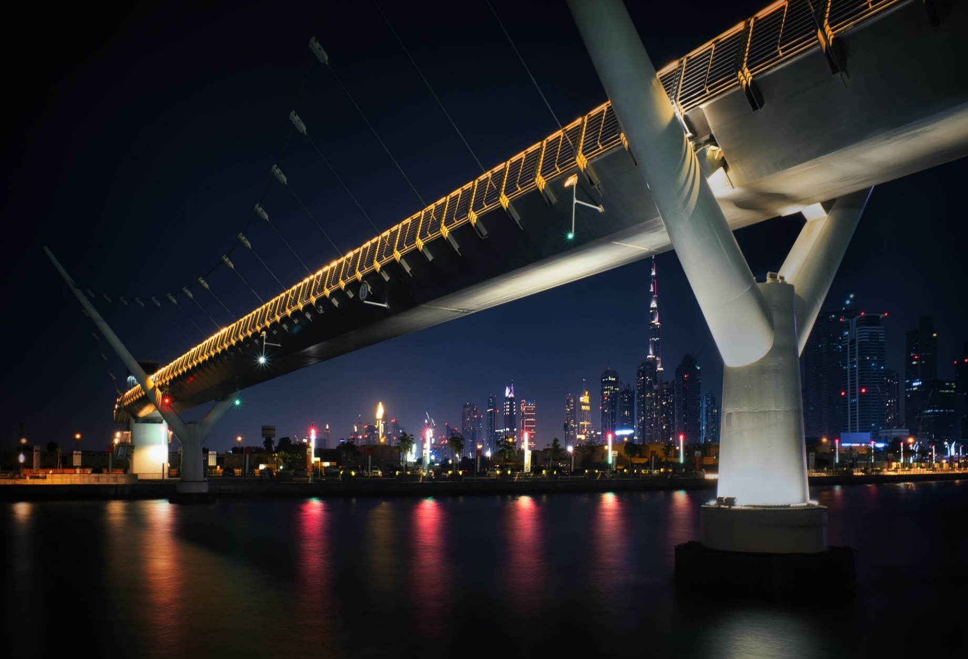
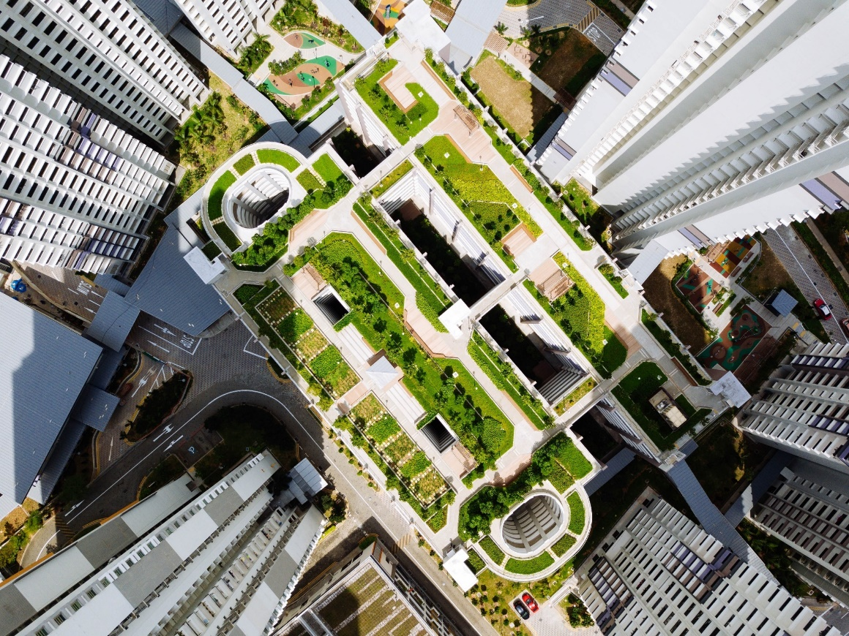
Quick Investigation: What is needed?
What will need to be powered as part of the site?
This will need to link with what you have looked at already.
Lighting?
Visitor Centre?
Toilets?
What else?
Notes:
If students are stuck at this point, start to talk about who will use the site, and what sorts of activities are going to be there.
Is it going to be used at night? Are there issues with safety? Use what they have learnt already to help direct the conversation

Slide 13
Practical Investigation

Slide 14
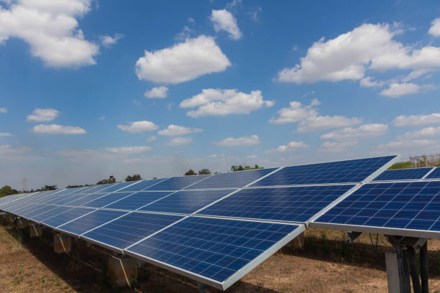

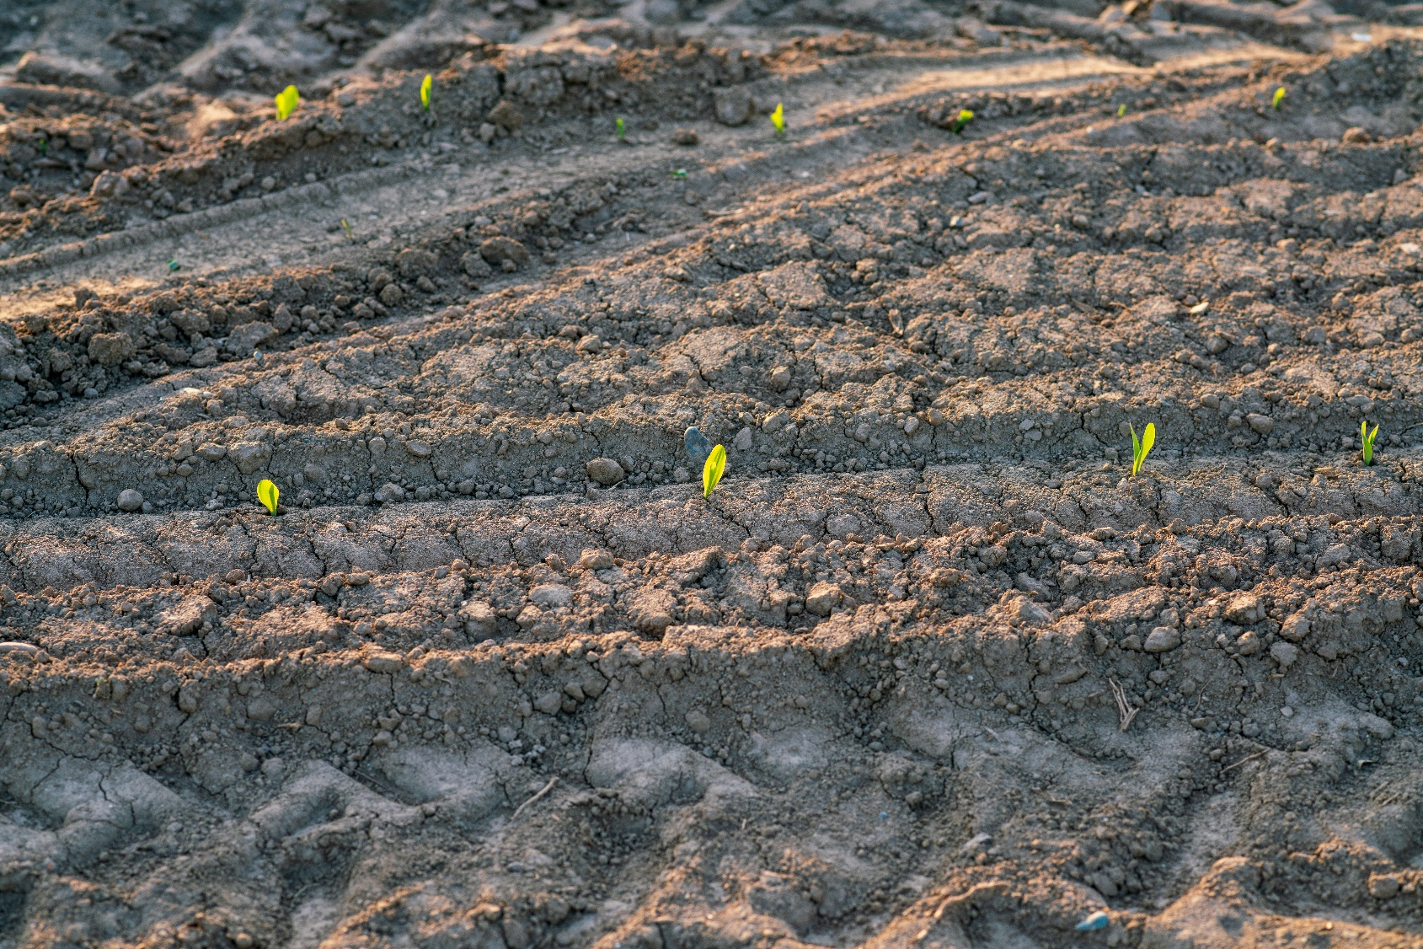
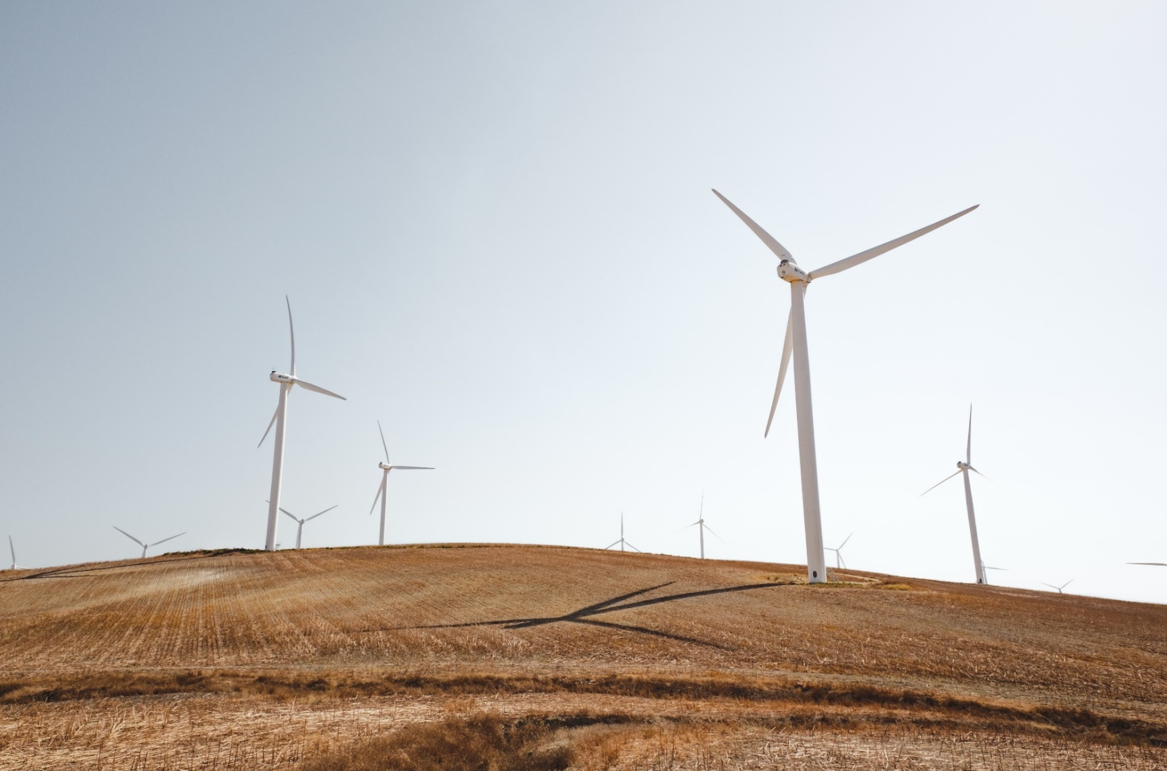
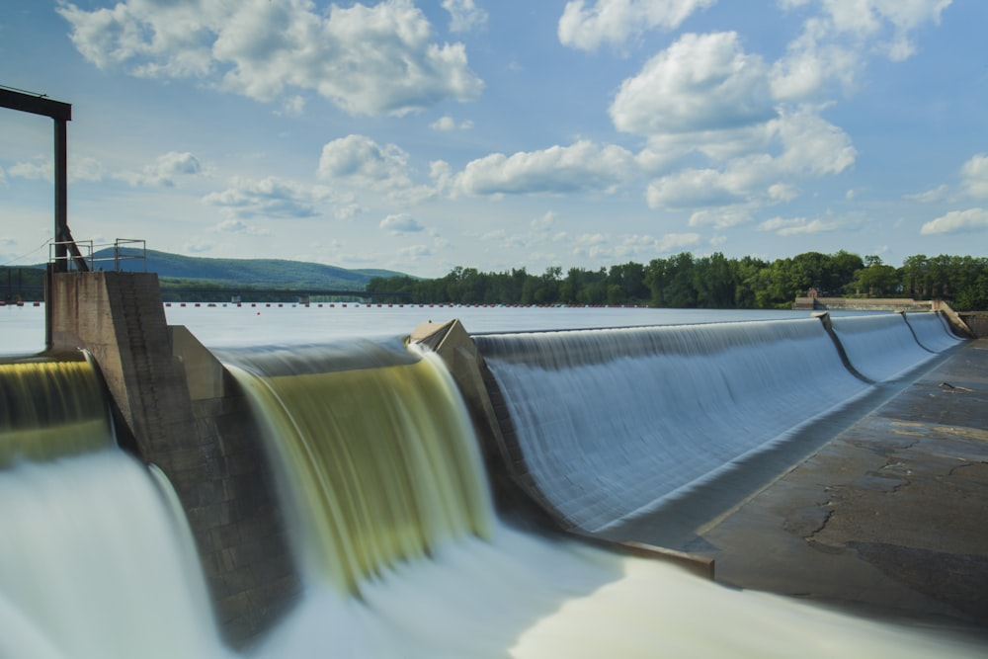
What are renewable energy sources?
Advantages and
disadvantages?
Notes:
Solar energy refers to technologies that convert the sun’s heat or light to another form of energy for use.
Biofuel is natural grown and burnt safely to create energy
Wind is used to turn mechanical systems which then generate electricity
Hydro uses the flow of water to turn turbines which produce electrical energy
What are the limitations of these as energy sources?

Slide 15
Which ones are most used?
Notes:
Wind and hydro contribute the most to overall energy so we will focus on these 2. Students can investigate alternative methods of energy

Slide 16
Hydropower
There are four types of hydropower:
Dammed systems (storage)
Pumped storage
Run-of-river
Wave and tidal (offshore)
Notes:
Run-of-river hydropower: a facility that channels flowing water from a river through a canal or penstock to spin a turbine. Typically, a run-of-river project will have little or no storage facility. Run-of-river provides a continuous supply of electricity (base load), with some flexibility of operation for daily fluctuations in demand through water flow that is regulated by the facility

Slide 17
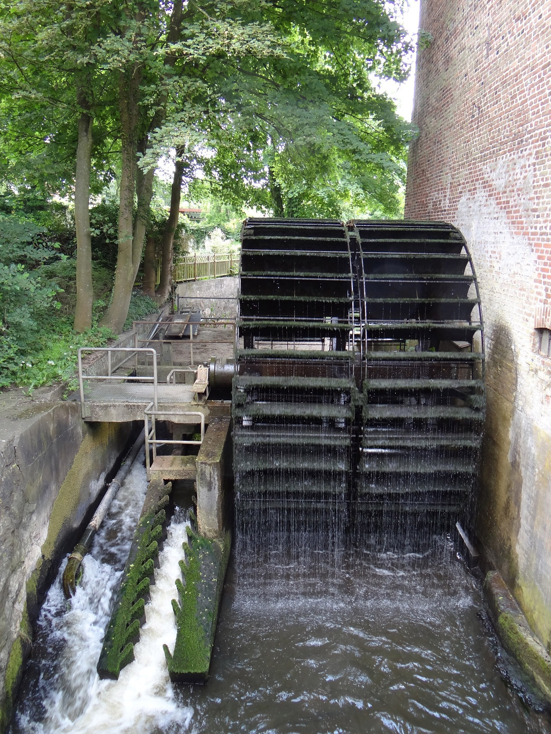
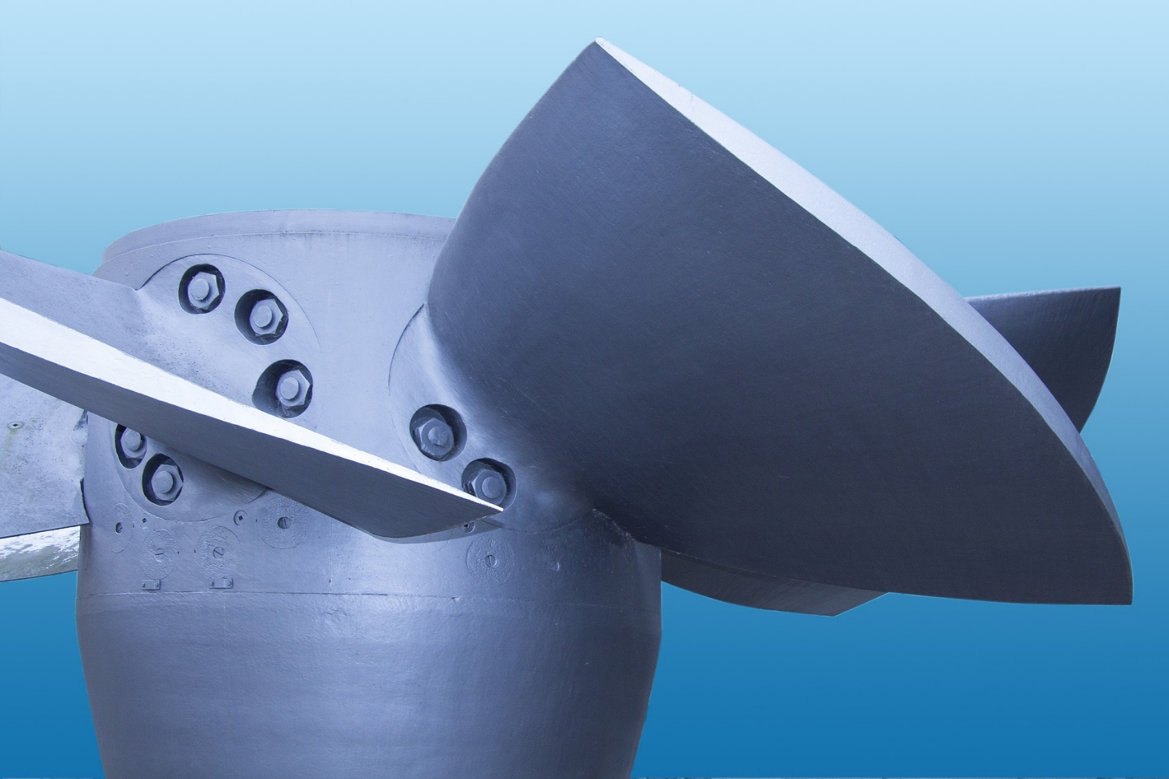

Run-of-river
The natural flow of a river is used to turn turbines, which produce electricity.
Notes:
Run-of-river hydropower: a facility that channels flowing water from a river through a canal or penstock to spin a turbine. Typically, a run-of-river project will have little or no storage facility. Run-of-river provides a continuous supply of electricity (base load), with some flexibility of operation for daily fluctuations in demand through water flow that is regulated by the facility

Slide 18
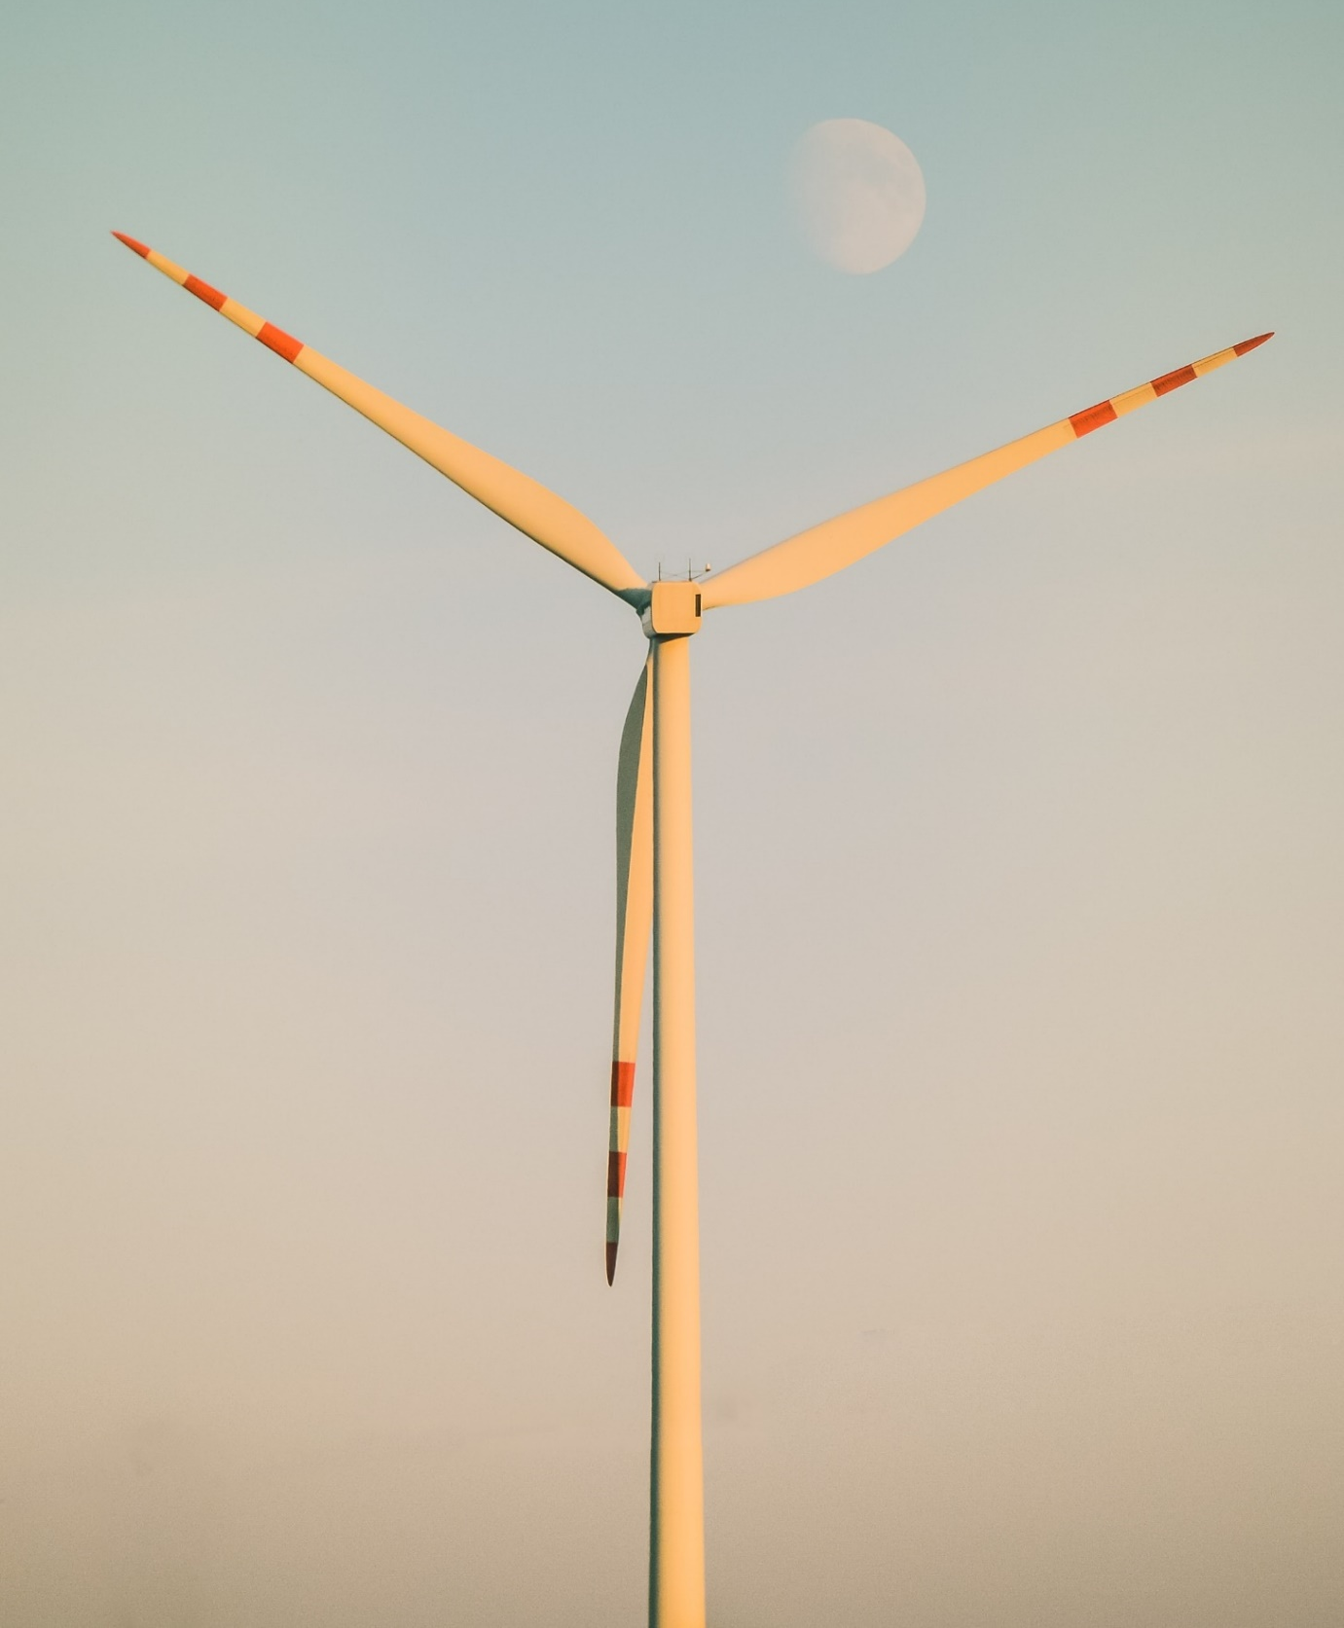
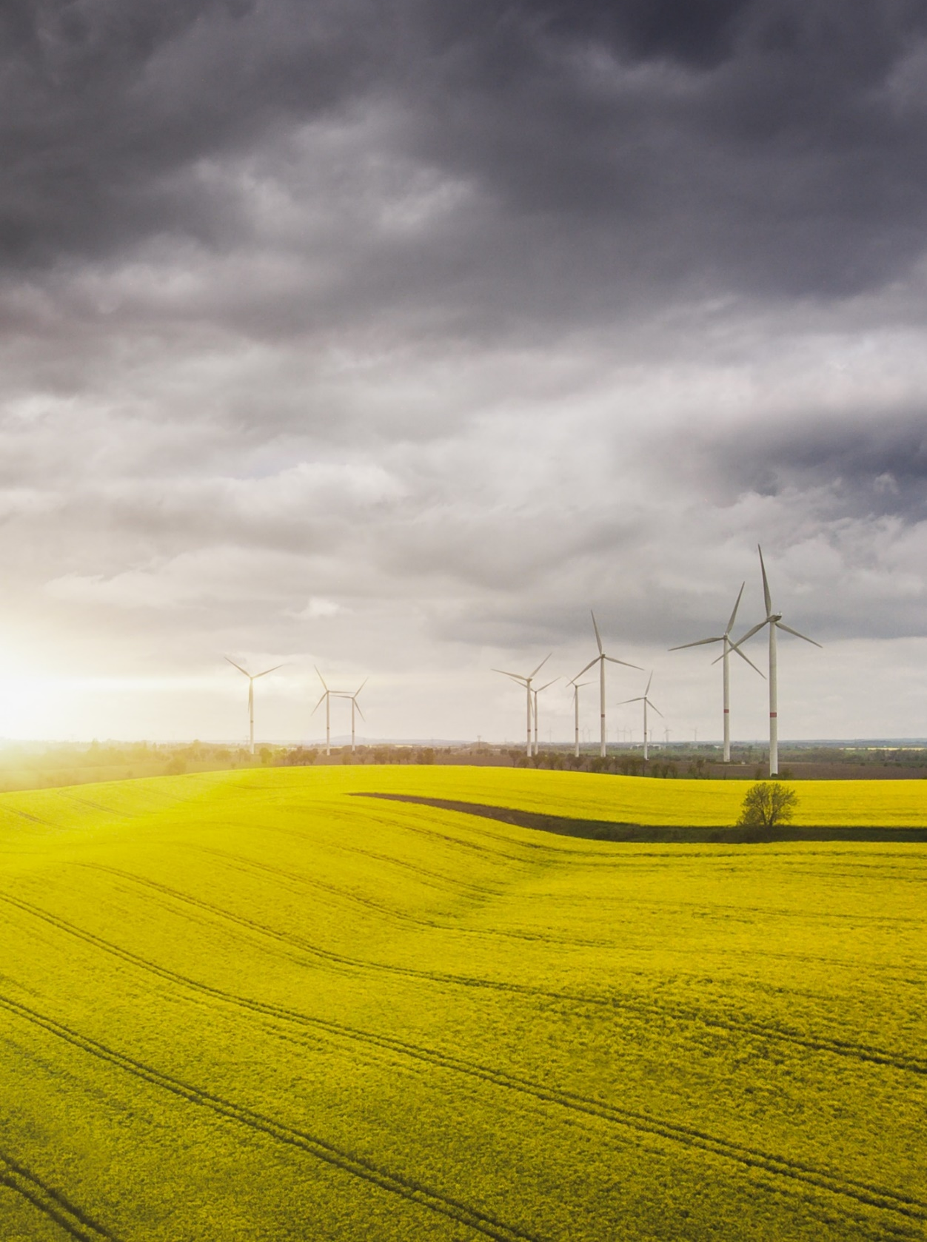
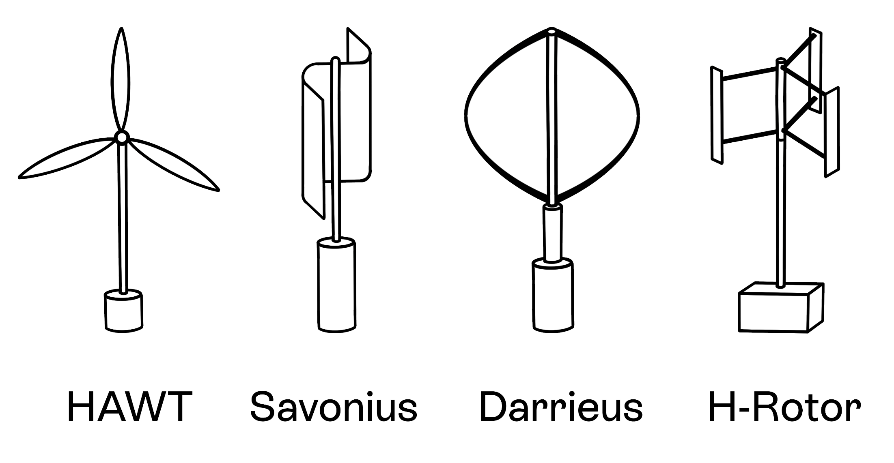
Wind power
The UK is the windiest country in Europe, and when sited in the right place wind turbines are a great way to generate renewable energy.
In some instances, simple windmills can be used to pump water.
Wind turbine designs
Horizontal mounted (HAWT) - similar to propeller blades
Vertically mounted (VAWT)
  Savonius
  Darrieus
  H-rotor or revolving wing
Notes:
Wind is created by the unequal heating of the Earth's surface by the sun. Wind turbines convert the kinetic energy in wind into mechanical power that runs a generator to produce clean electricity. Today's turbines are versatile modular sources of electricity. Their blades are aerodynamically designed to capture the maximum energy from the wind. The wind turns the blades, which spin a shaft connected to a generator or the generator's rotor, which makes electricity.
As wind is less reliable, battery storage systems should be considered to store energy when demand is low

Slide 19
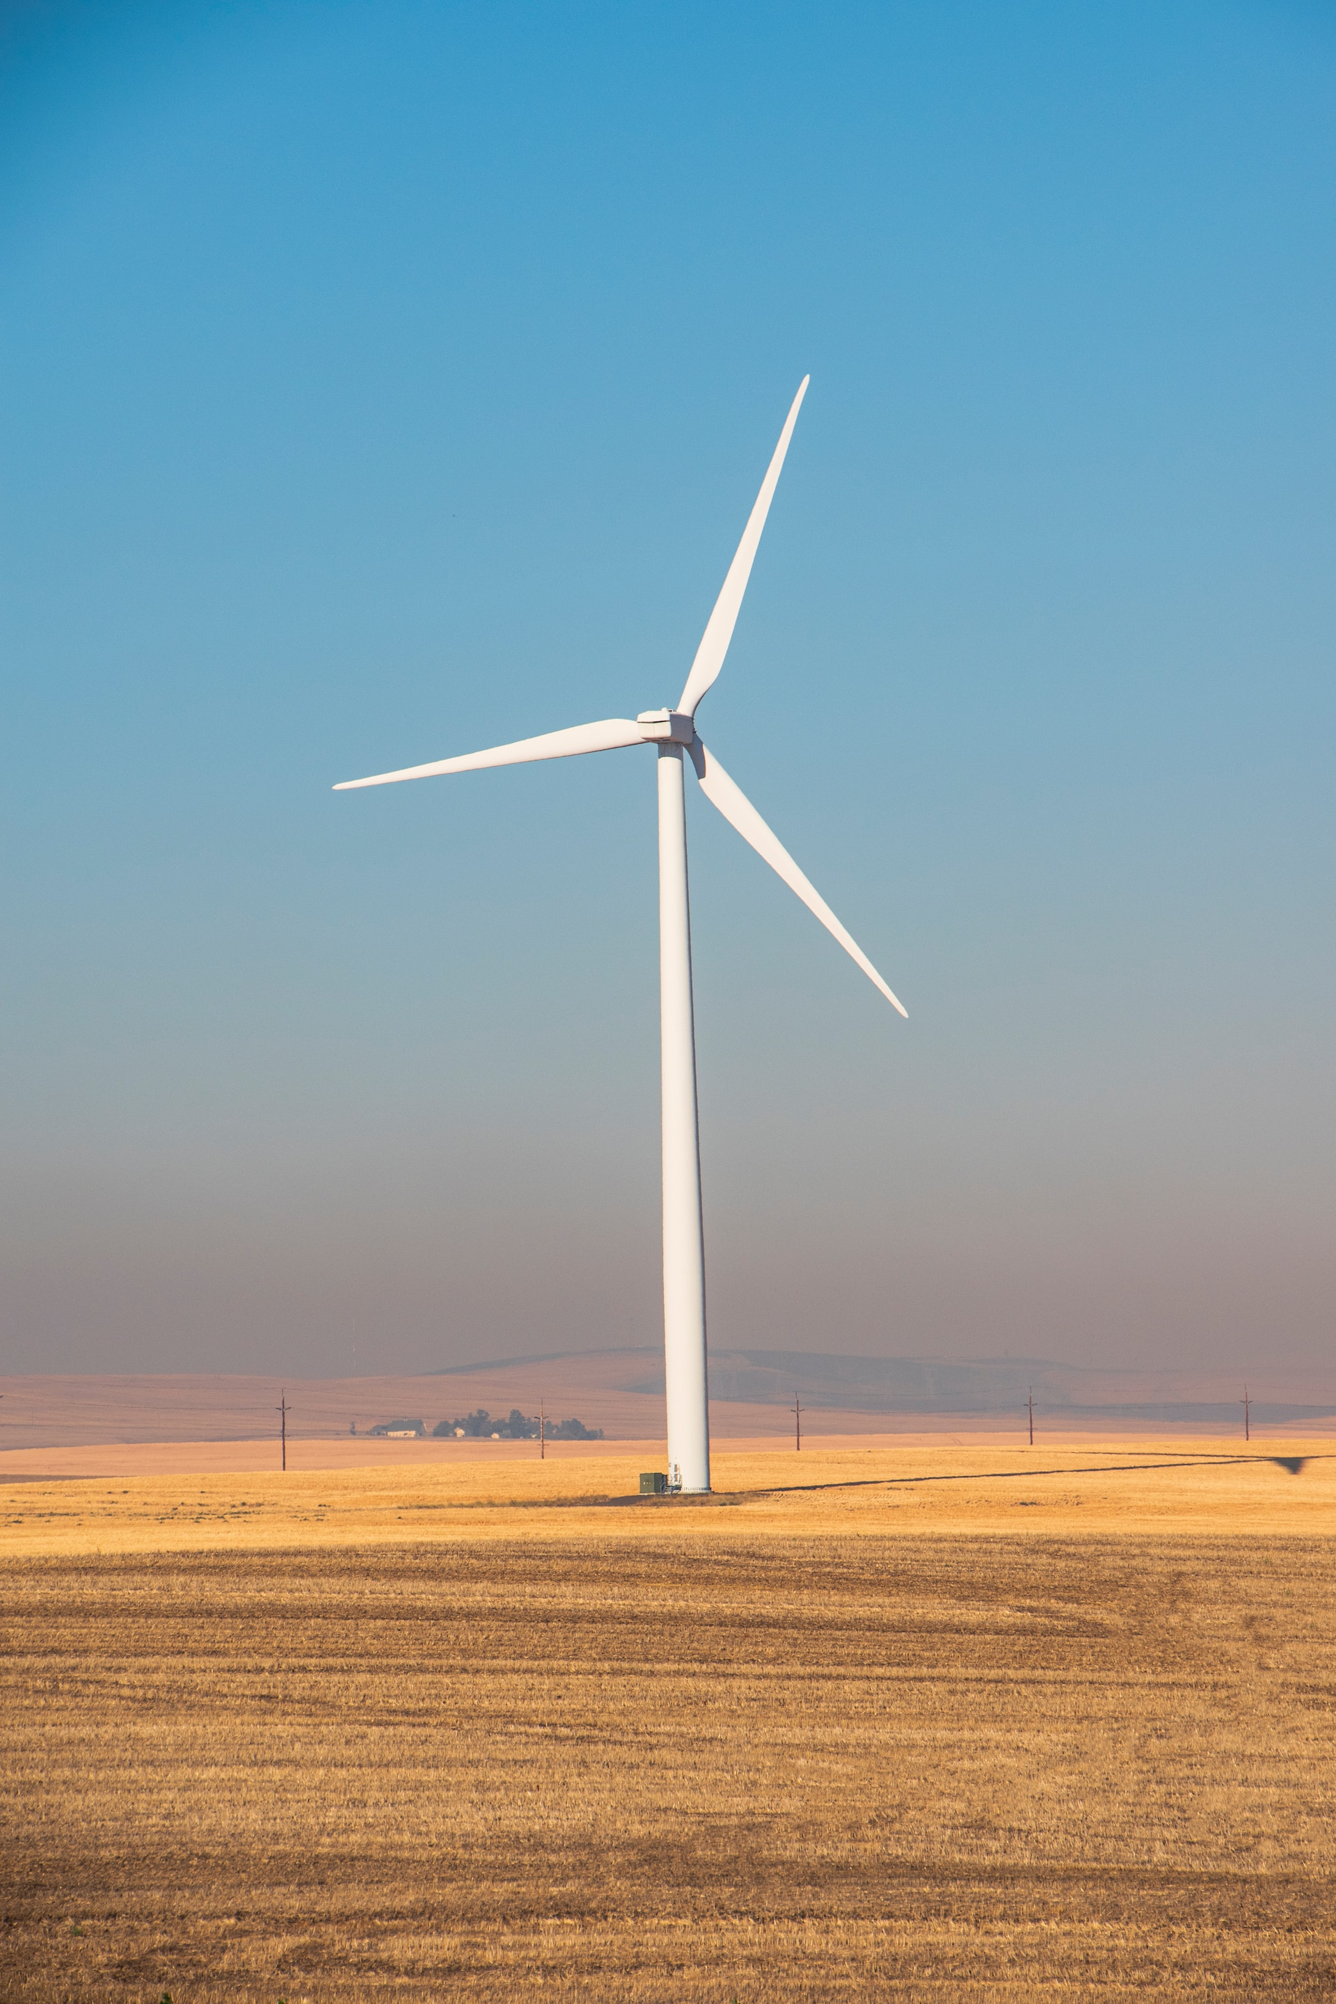
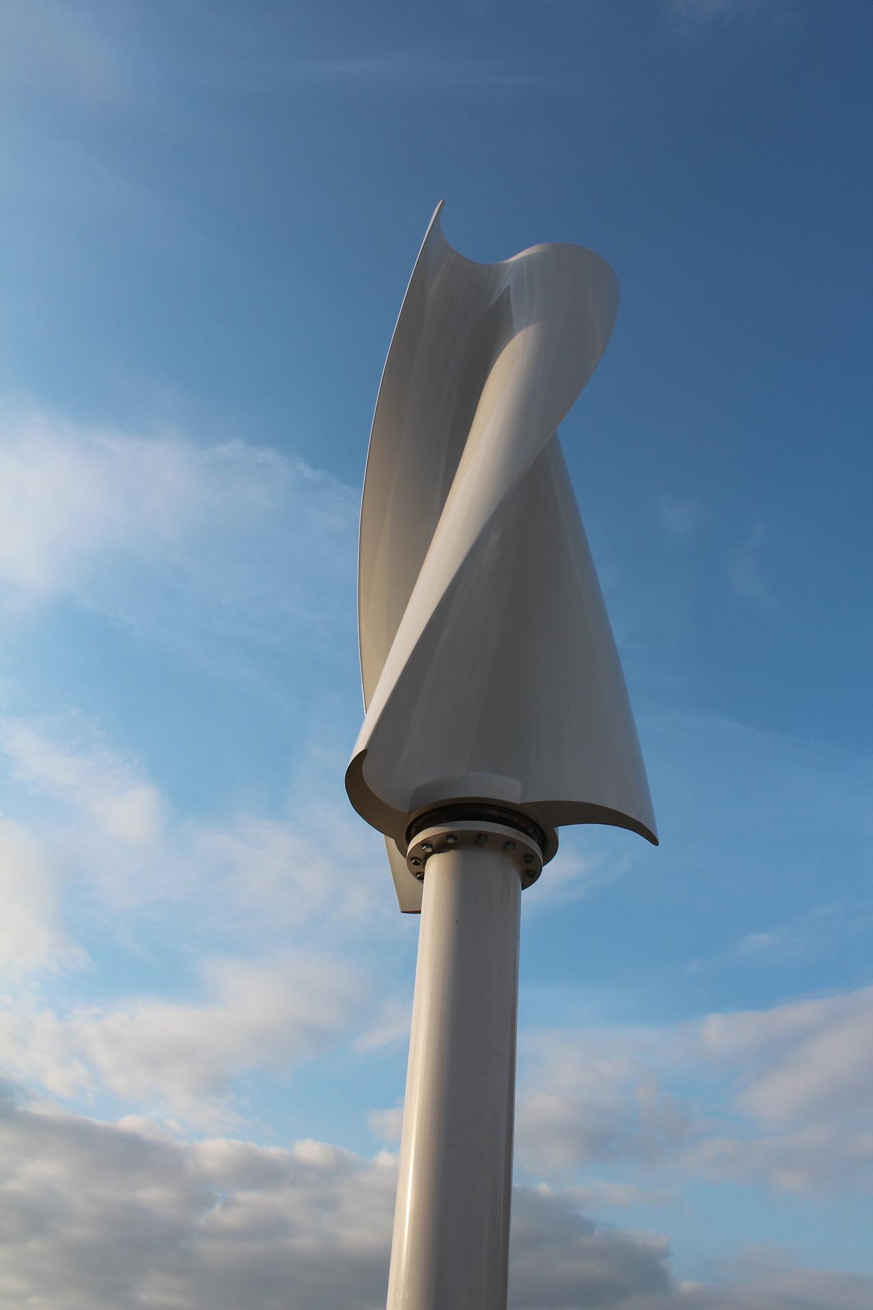
Examples
HAWT
Savonius rotor

Slide 20
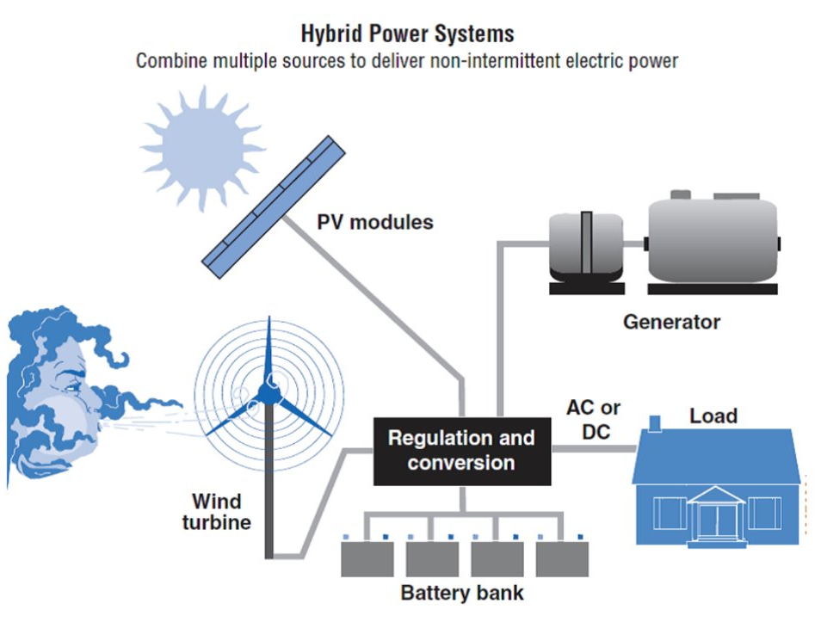
Hybrid Systems
Image from: https://windexchange.energy.gov/small-wind-guidebook
Notes:
It is worth explaining how renewable energy forms part of a wider system to deliver on demand power. This may be backed up by diesel generators or direct power from the national grid.
Further research could be done later into ground source heat pumps, solar power or the use of bio fuels

Slide 21
Energy storage
One of the key issues with renewables is that demand does not always match supply.
You need to consider how you might store energy for use at other times.
In simple terms, it is not sunny at nighttime, when you need to power lighting.
Electricity can be stored in electrical batteries.
Can be converted into heat and stored in a heat battery.
Heat can also be stored in thermal storage, such as a hot water cylinder.
Flywheels can also be used as mechanical storage.
Visit this site for more information: https://studentenergy.org/distribution/energy-storage/
Notes:
An energy storage system allows you to capture heat or electricity when it is readily available, typically from a renewable energy system, storing it for you to use later. The most common energy storage systems include electric batteries, heat batteries and thermal stores.

Slide 22
Research
Using the information in this power point, the links, and further information, your job is to now conduct your own research into appropriate renewable sources, suited to the site you are looking at.
Look at Worksheet 4 to help you get started.

Slide 23
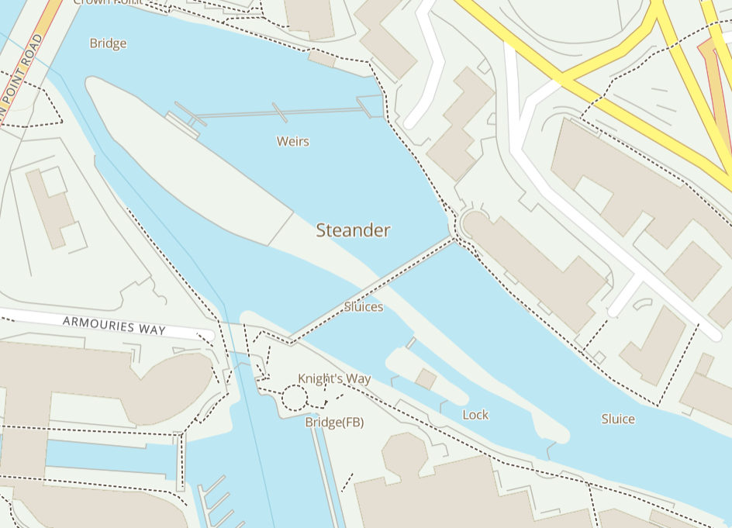
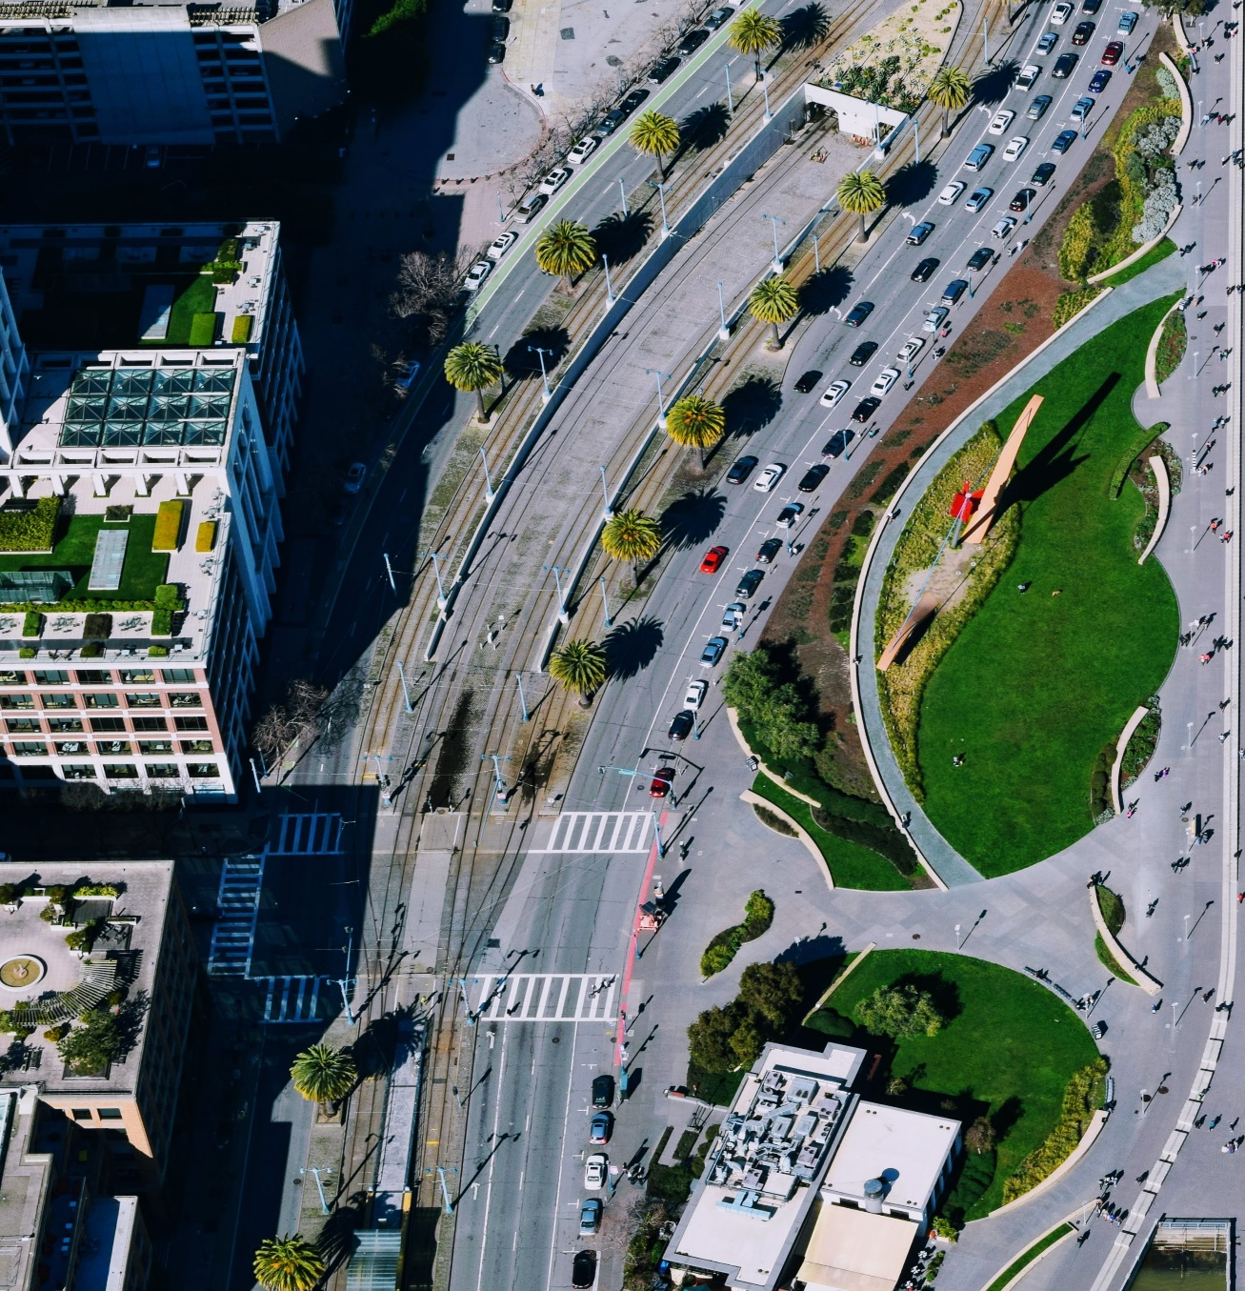
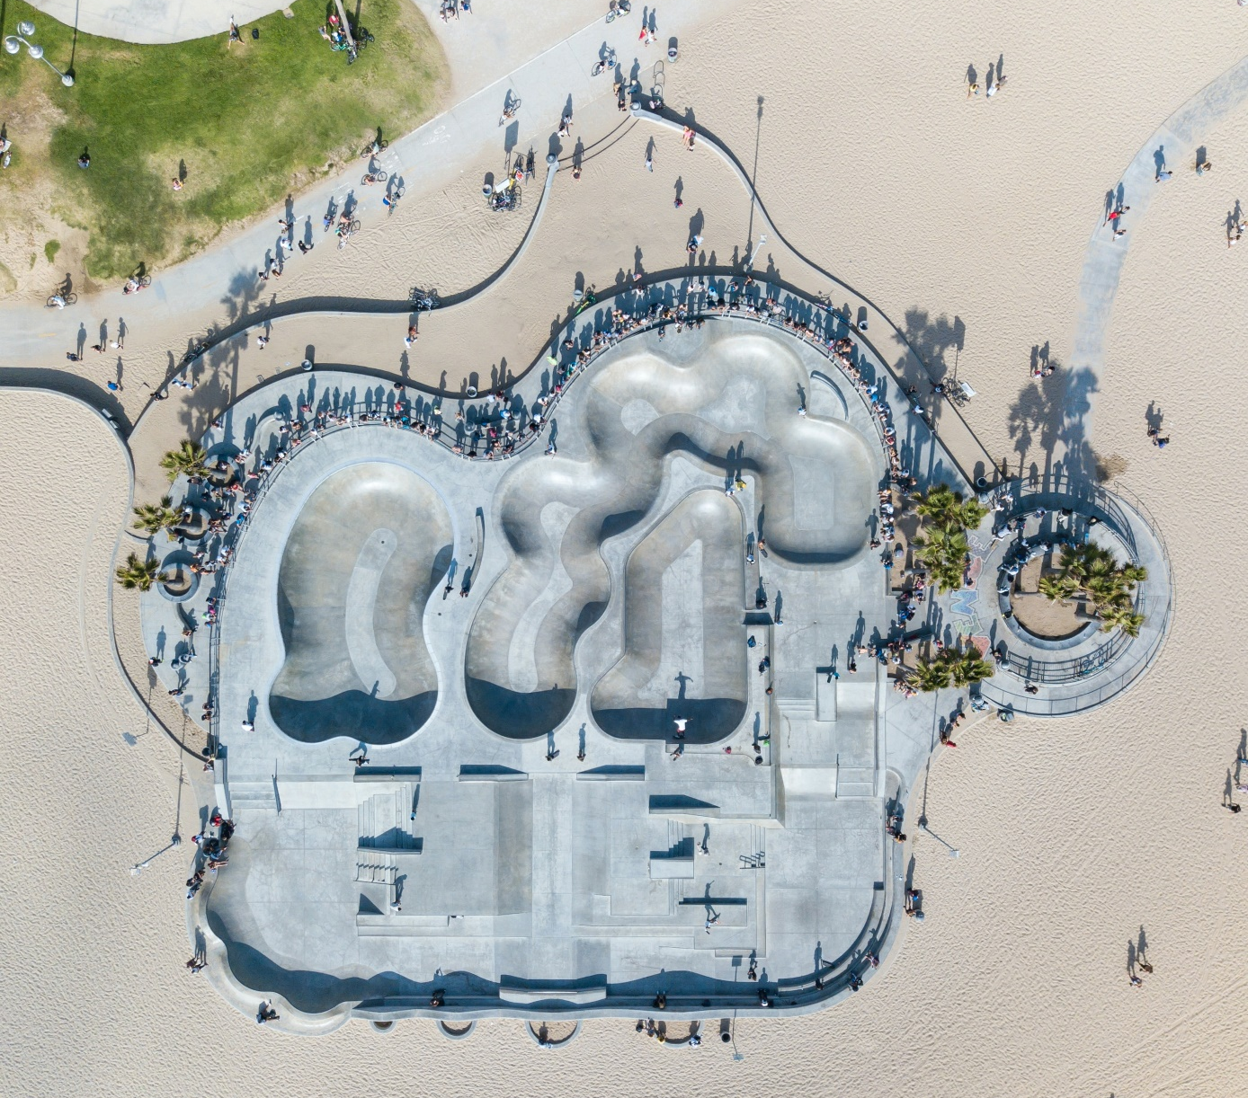
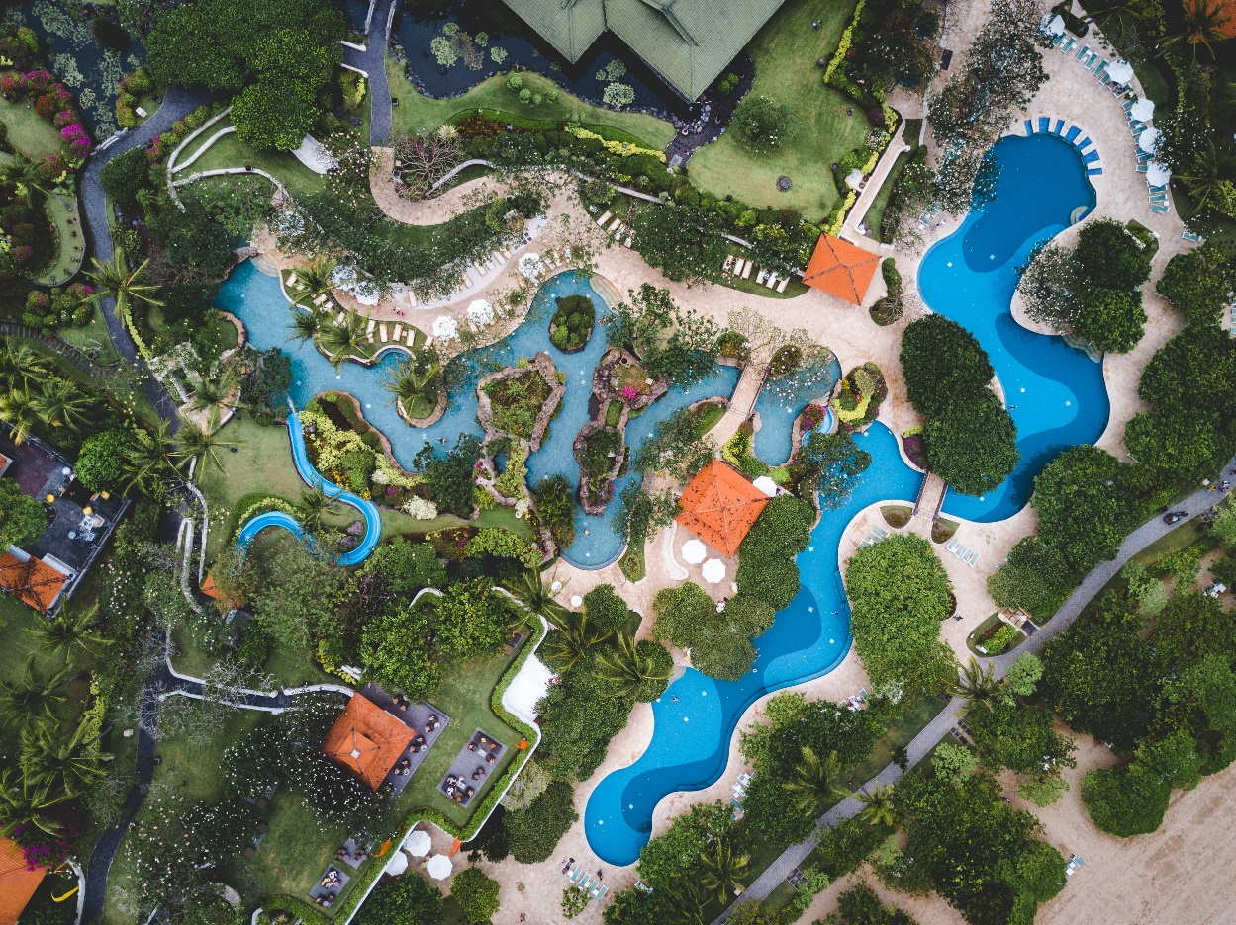
The Challenge
Working in teams, you will design a layout for Smeaton Park that includes accessibility, informative displays about John Smeaton, his work and civil engineering.
You must also use your knowledge of renewable energy sources to identify a system that will be used to generate the electricity for the park.
Notes:
The students will be given the following spec as part of a more detailed challenge.
•The park must be enclosed in the area identified on the map.
•You should propose where access to the island will be from.
•You must consider access to the site for visitors of all abilities and ages.
•The park must include various features and displays about John Smeaton and his work.
•Your renewable energy source must be clearly shown and located and be justified in your proposal.
•Your proposal must include a map or model of the layout.
•Consider the environmental impact of the site from construction to use.

Slide 24
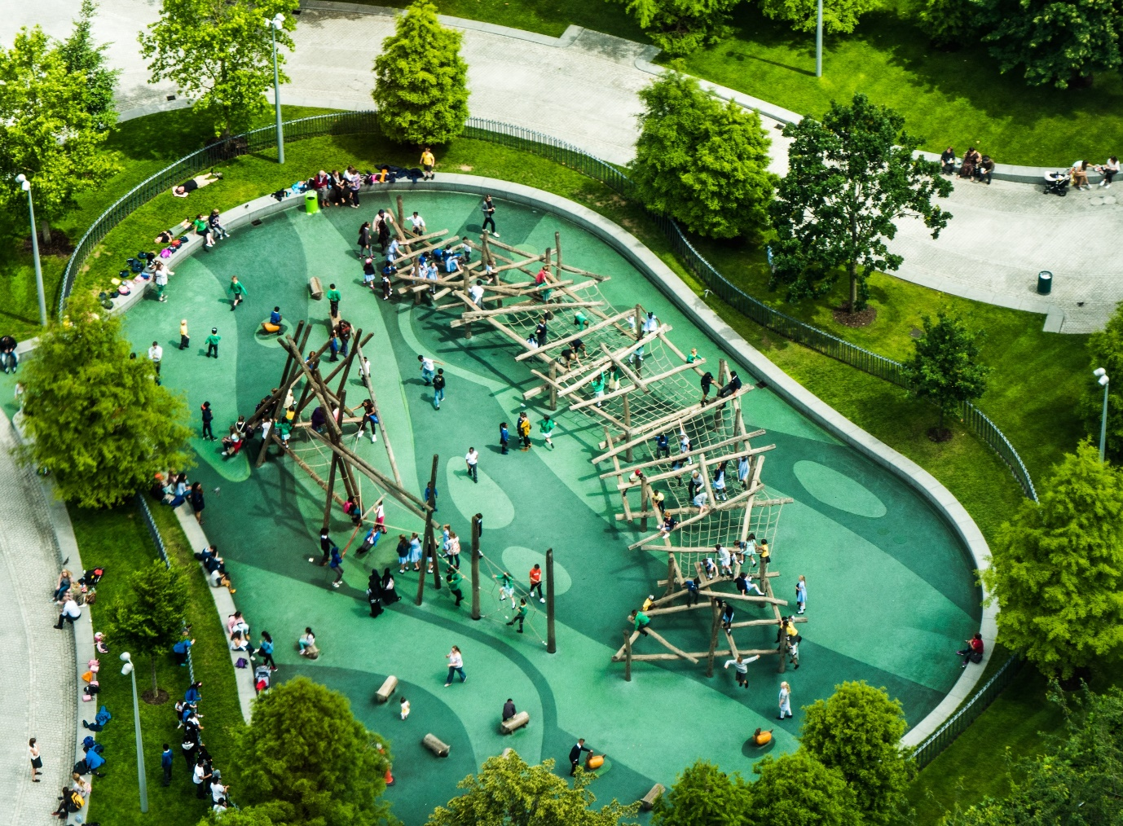
Mark scheme
Presentations should last 5 minutes.
Every team member must contribute to the presentation.
At the end other teams should ask questions.
Mark allocation:
1. Quality of the plan/layout (10 marks)
2. Accessibility – different users – uses/times of the day etc.
(10 marks)
3. Renewable energy source (10 marks)
4. Features/information (reference to Smeaton and engineering) (10 marks)
5. Environmental impact (5 marks)
6. Quality of presentation (5 marks)
Total 50 marks.

Slide 25
Passport

